Slide 1
File storage using blockchain technology
By Lukeera Michael Elywin S19B23656

Slide 2

Introduction
Blockchain is a technology that permits recording information in a way that makes it difficult or nearly impossible to change, hack or cheat the system.

Slide 3
Blockchain
Blockchain is a shared, immutable ledger that facilitates the process of recording transactions and tracking assets in a business network. An asset can be tangible (a house, car, cash, land) or intangible (intellectual property, patents, copyrights, branding). Virtually anything of value can be tracked and traded on a blockchain network, reducing risk and cutting costs for all involved.

Slide 4
Key elements of blockchain technology
Distributed Ledger technology
Immutable records
Smart contracts
To speed transactions, a set of rules called a smart contract is stored on the blockchain and executed automatically.
All network participants have access to the distributed ledger and its immutable record of transaction.
No participant can change or tamper with a transaction after it’s been recorded to the shared ledger.
Note: If a transaction record includes an error, a new transaction must be added to reverse the error, and both transactions are then visible.
A smart contract can define conditions for corporate bond transfers, include terms for travel insurance to be paid and much more.
Competitors

Slide 5
Why use blockchain?

Slide 6
Why use blockchain technology
Trust
Security
Consensus on data accuracy is required from all network members, and all validated transactions are immutable because they are recorded permanently. No one, not even a system administrator, can delete a transaction.
With blockchain, as a member of a members-only network, you can rest assured that you are receiving accurate and timely data, and that your confidential blockchain records will be shared only with network members to whom you have specifically granted access.

Slide 7
Why use blockchain technology cont…
Efficiency
With a distributed ledger that is shared among members of a network, time-wasting record reconciliations are eliminated. And to speed transactions, a set of rules called a smart contract can be stored on the blockchain and executed automatically.

Slide 8
Problem statement
Academic records of an individual, such as degrees, diplomas, are separated data, stored in the databases of various providers of education and students or graduates do not have the authority to manage their own information. Moreover, no other unofficial person (e.g. an employer) has access to modify or even view these official records, in the context of heightened internationalization of education and work, with the increasing mobility of students and graduates, easy access to personal degree records is paramount.

Slide 9
Objectives
Reliability
Availability
Allow users to control their data through private and public keys, allowing them to own it.
Make information unchanged, immutable, and distributed over time in that any system participant can verify the authenticity of data and be certain it has not been tampered with thus the records are secure.
Competitors

Slide 10

Methodology
Observation: Observation of students’ behavior during the times of job seeking will be used to assess their reactions and attitude toward the current system.
Interview: Several interviews will be conducted for both the students(graduates) and staff to find out their requirements for the System.
Questionnaires and Online survey: Several online surveys and physical questionnaires are going to be used in order to collect data from both graduates and staff about the current system and their requirements for the new system.
Online survey: Research from different and various researchers will be used to understand and get a comprehensive understanding of the technology and application.

Slide 11
System Design

Slide 12
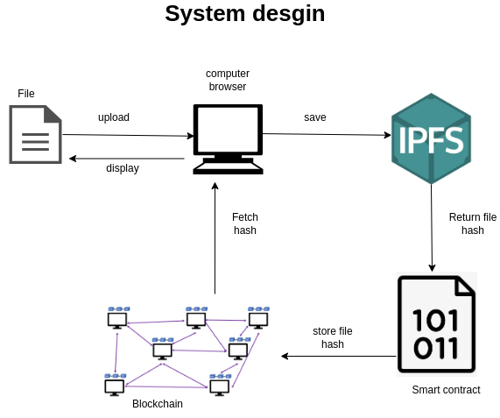

Slide 13
—Nelson Mandela
“The greatest glory in living lies not in never falling, but in rising every time we fall.”

Slide 14
Thank you!

Slide 15

Lukeera Michael Elywin
Team
lukeeraelywin@gmail.com
elywin.github.io

